Slide 1

D&D Group Finder
By: Matthew Berwick & Arodi Kapuadi

Slide 2
Player Use Case

Slide 3
Player Use Case

Slide 4
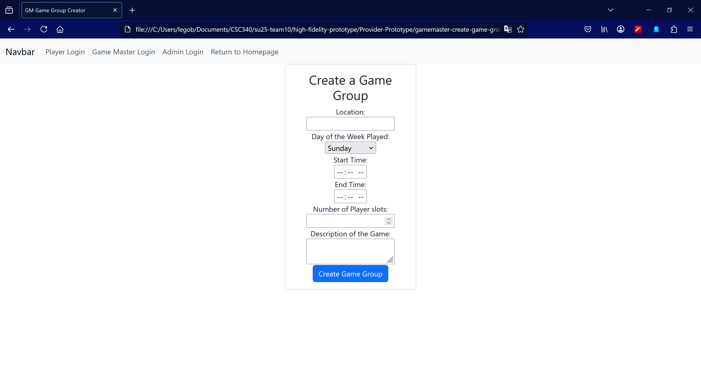
Game Master Creating a Game Group
On this page, a game master user can create a game group, which would be added to a database of all game group.
They will need to enter all the information, which includes the location, the day of the week the game will be played, start/end time, number of player slots, and the description.

Slide 5
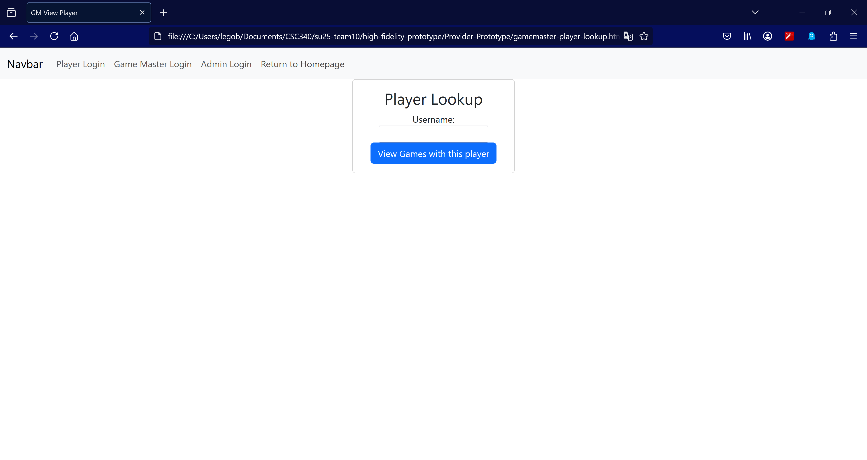
Game Master Viewing the Game Groups of a Player
This page allows a Game Master user to view all game groups of a specific Player user.
This will display all the relevant data about each game group.
This would allow them to see if there are any schedule conflicts with said Player user, either from time or location.

